Slide 1


American University of Beirut
MECH 674
Energy Economics and Policy
Dr. Carine Habchi
Project : CCDV vs Mixed-mode Ventilation Economic Analysis
Prepared by:
Ahmad El Haj
Jihad Jundi
Mohammad El Masri

Slide 2
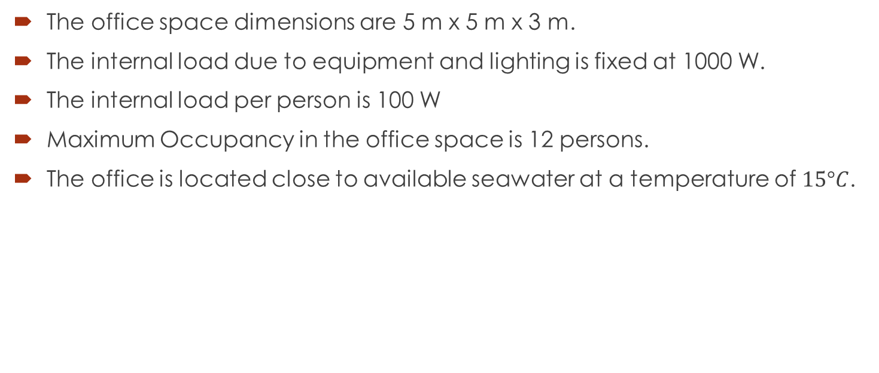
Problem
The office space dimensions are 5 m x 5 m x 3 m.
The internal load due to equipment and lighting is fixed at 1000 W.
The internal load per person is 100 W
Maximum Occupancy in the office space is 12 persons.
The office is located close to available seawater at a temperature of $15°C$.

Slide 3

Problem
The occupancy and weather conditions are given per hour of the day.
After calculation, we find the maximum load to be 88 W/$m^{2}$
What should we use to solve our problem?

Slide 4
Different options?
Option 1: Mixed-mode ventilation system using mechanical systems like windows and refrigeration systems in order to provide adjustable ventilation.
  Information was taken from a previous study done on a bigger office building.
  This will be powered purely by a diesel generator.
Option 2: CC-DV system which we will design and size accordingly.
  We will use seawater in order to cool our chilled ceiling.
  A fan of efficiency 0.5 and a pressure difference of 1.5 kPa will be used in order to supply air in the DV system.
  A pump of efficiency 0.8 and a pump head of 4 m will be used in order to circulate seawater to the chilled ceiling.
  This will be powered 50% by a diesel generator and 50% by PV panels.

Slide 5
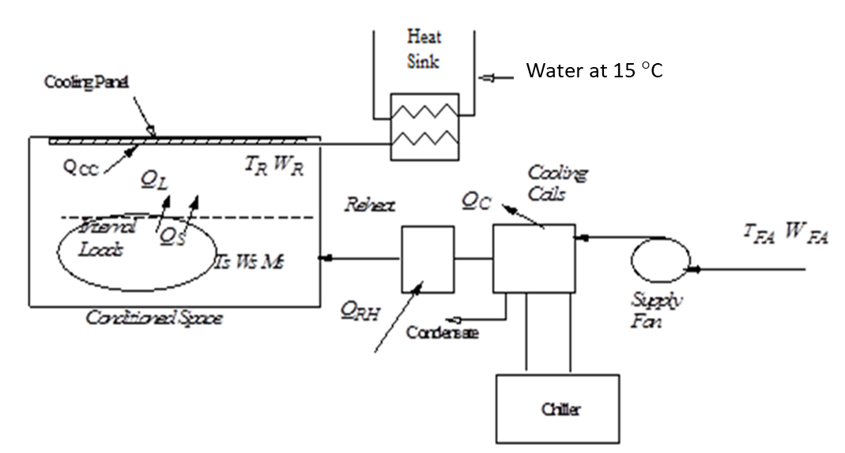
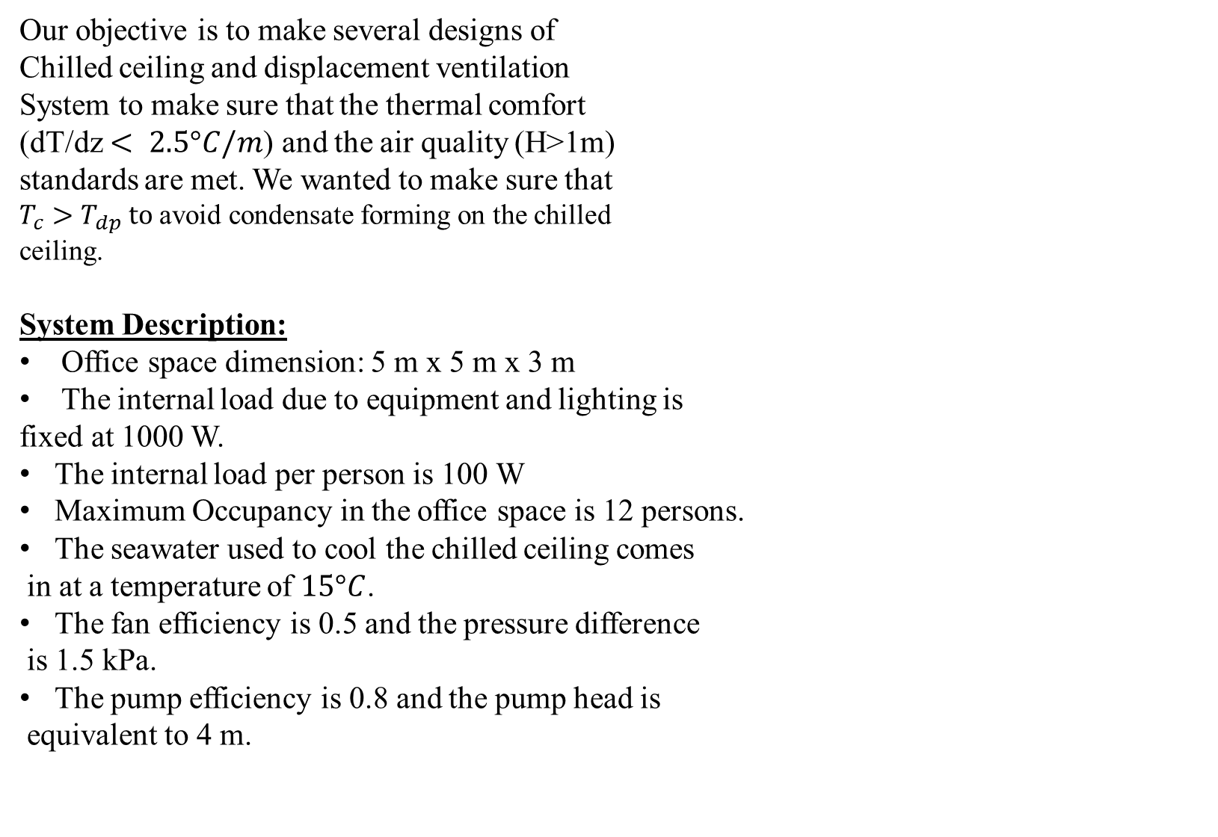
Our objective is to make several designs of
Chilled ceiling and displacement ventilation
System to make sure that the thermal comfort
(dT/dz $< 2.5°C/m$) and the air quality (H>1m)
standards are met. We wanted to make sure that
$T_{c}>T_{dp} to$avoid condensate forming on the chilled
ceiling.
System Description:
Office space dimension: 5 m x 5 m x 3 m
The internal load due to equipment and lighting is
fixed at 1000 W.
The internal load per person is 100 W
Maximum Occupancy in the office space is 12 persons.
The seawater used to cool the chilled ceiling comes
in at a temperature of $15°C$.
The fan efficiency is 0.5 and the pressure difference
is 1.5 kPa.
The pump efficiency is 0.8 and the pump head is
equivalent to 4 m.

Slide 6
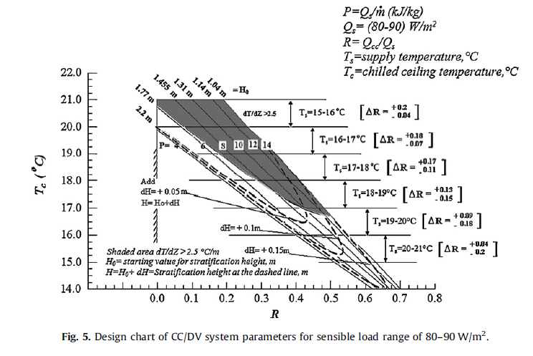
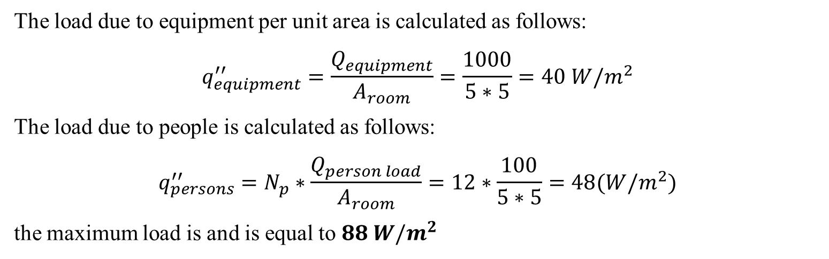
The load due to equipment per unit area is calculated as follows:
$$q_{equipment}^{′′}=\frac{Q_{equipment}}{A_{room}}=\frac{1000}{5∗5}=40 W/m^{2}$$
The load due to people is calculated as follows:
$$q_{persons}^{′′}=N_{p}∗\frac{Q_{person load}}{A_{room}}=12∗\frac{100}{5∗5}=48(W/m^{2})$$
the maximum load is and is equal to $88 W/m^{2}$

Slide 7
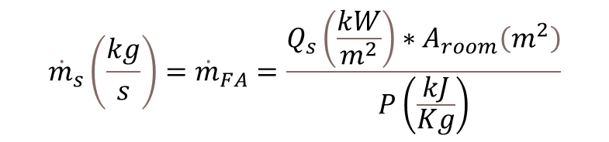
Design | P | mdot | Tc | Ts | R | H | dT/dZ
1 | 4 | 0.55 | 17 | 18 | 0.3 | 1.7218 | 1.1621
2 | 6 | 0.37 | 17 | 18 | 0.35 | 1.6456 | 1.25545
3 | 8 | 0.28 | 16 | 19 | 0.475 | 1.5801 | 1.460825
4 | 10 | 0.22 | 16 | 19 | 0.525 | 1.5039 | 1.554175
5 | 12 | 0.18 | 15.5 | 20.5 | 0.575 | 1.4702 | 1.703525
6 | 14 | 0.16 | 15.5 | 20.5 | 0.6 | 1.3961 | 1.8022
The supplied mass flow rate ${\dot{m}}_{s}$ can be calculated using the below formula:
$${\dot{m}}_{s}\left(\frac{kg}{s}\right)={\dot{m}}_{FA}=\frac{Q_{s}\left(\frac{kW}{m^{2}}\right)∗A_{room}\left(m^{2}\right)}{P\left(\frac{kJ}{Kg}\right)}$$

Slide 8
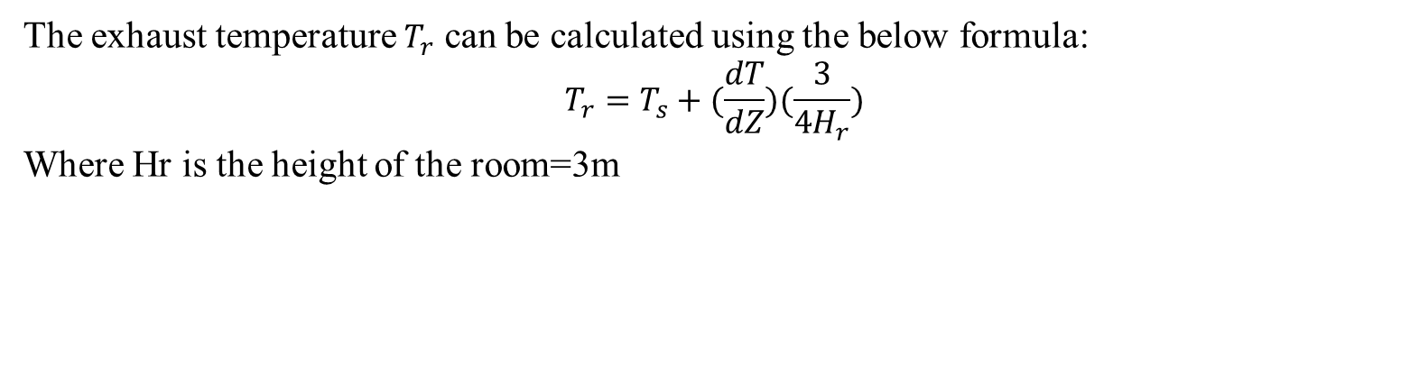
The exhaust temperature $T_{r}$ can be calculated using the below formula:
$$T_{r}=T_{s}+(\frac{dT}{dZ})(\frac{3}{4H_{r}})$$
Where Hr is the height of the room=3m
Design | P | mdot | Ts | dT/dZ | Tr
1 | 4 | 0.55 | 18 | 1.1621 | 20.61473
2 | 6 | 0.37 | 18 | 1.25545 | 20.82476
3 | 8 | 0.28 | 19 | 1.460825 | 22.28686
4 | 10 | 0.22 | 19 | 1.554175 | 22.49689
5 | 12 | 0.18 | 20.5 | 1.703525 | 24.33293
6 | 14 | 0.16 | 20.5 | 1.8022 | 24.55495

Slide 9

The energy removed by the ceiling $Q_{cc}$ and that removed by the displacement ventilation $Q_{SDV}$ are added up sensible load generated in the room. They can be determined by the following relations:
$Q_{cc}=R∗Q_{s}∗A_{room}$
$Q_{SDV}=Q_{s}A_{room}$- $Q_{cc}$
Design | R | Qs | Qcc | Qsdv
1 | 0.3 | 88 | 660 | 1540
2 | 0.35 | 88 | 770 | 1430
3 | 0.475 | 88 | 1045 | 1155
4 | 0.525 | 88 | 1155 | 1045
5 | 0.575 | 88 | 1265 | 935
6 | 0.6 | 88 | 1320 | 880

Slide 10

Design | mdot | Wv
1 | 0.55 | 0.000305
2 | 0.37 | 0.000458
3 | 0.28 | 0.000611
4 | 0.22 | 0.000764
5 | 0.18 | 0.000916
6 | 0.16 | 0.001069
The humidity ratio due to water vapor generated by the occupants is given by:
$$W_{v}=\frac{N_{p}{\dot{w}}_{p}}{{\dot{m}}_{s}}$$
Where ${\dot{w}}_{p}$ is the water vapor rate generated by each person equals to $1.4∗{10}^{−5} \frac{kg of H2O}{kg of air} per second$

Slide 11

The maximum allowable humidity ratio of air near the ceiling to avoid condensation at the dew point temperature.
$$HR \left(w_{a,\max{}}\right)=\%\frac{\exp\left(\frac{17.625∗T_{dp,min}}{243.04+T_{dp,min}}\right)}{\exp\left(\frac{17.625∗T_{r}}{243.04+T_{r}}\right)}$$
Where the dew point temperature of the ceiling is $T_{dp,min}=T_{c}−1.5°$
Design | Tc | Tdp,min | Tr | HR (wa, max)
1 | 17 | 15.5 | 20.61473 | 0.007251
2 | 17 | 15.5 | 20.82476 | 0.007158
3 | 16 | 14.5 | 22.28686 | 0.006138
4 | 16 | 14.5 | 22.49689 | 0.00606
5 | 15.5 | 14 | 24.33293 | 0.005252
6 | 15.5 | 14 | 24.55495 | 0.005182

Slide 12
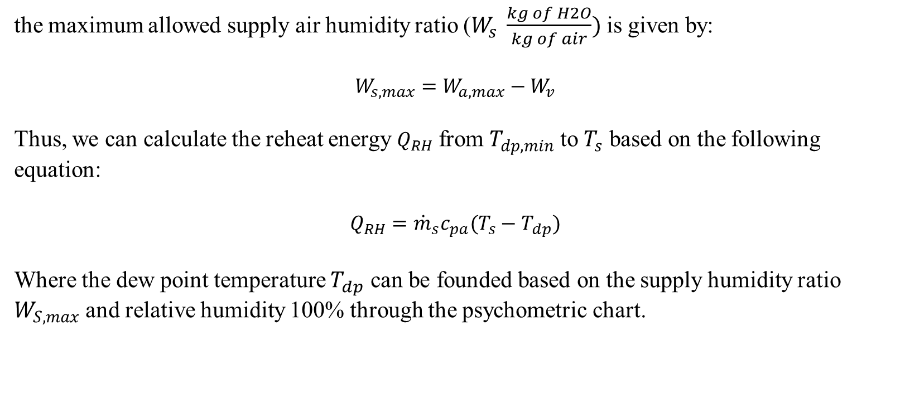
the maximum allowed supply air humidity ratio ($W_{s} \frac{kg of H2O}{kg of air})$ is given by:
$$W_{s,max}=W_{a,max}−W_{v}$$
Thus, we can calculate the reheat energy $Q_{RH}$ from $T_{dp,min}$ to $T_{s}$ based on the following equation:
$$Q_{RH}={\dot{m}}_{s}c_{pa}(T_{s}−T_{dp})$$
Where the dew point temperature $T_{dp}$ can be founded based on the supply humidity ratio $W_{S,max}$ and relative humidity 100% through the psychometric chart.
Design | HR (wa, max) | Wv | Ws. Max | Tdp | Qrh
1 | 0.007251 | 0.000305 | 0.006946 | 8.572 | 5185.4
2 | 0.007158 | 0.000458 | 0.0067 | 8.001 | 3666.3
3 | 0.006138 | 0.000611 | 0.005527 | 5.291 | 3769.975
4 | 0.00606 | 0.000764 | 0.005296 | 4.682 | 3149.96
5 | 0.005252 | 0.000916 | 0.004335 | 1.871 | 3415.317
6 | 0.005182 | 0.001069 | 0.004113 | 1.142 | 3041.971

Slide 13
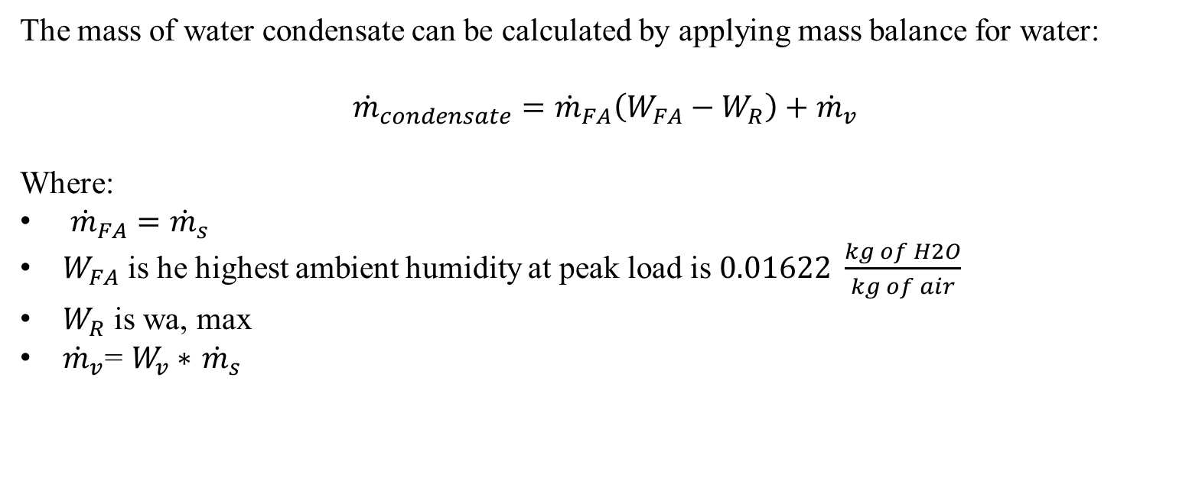
The mass of water condensate can be calculated by applying mass balance for water:
$${\dot{m}}_{condensate}={\dot{m}}_{FA}\left(W_{FA}−W_{R}\right)+{\dot{m}}_{v}$$
Where:
${\dot{m}}_{FA}={\dot{m}}_{s}$
$W_{FA}$ is he highest ambient humidity at peak load is $0.01622 \frac{kg of H2O}{kg of air}$
$W_{R}$ is wa, max
${\dot{m}}_{v}$= $W_{v}∗$ ${\dot{m}}_{s}$
Design | mFA | HR (wa, max) | Wv | mdot | m cond
1 | 0.55 | 0.007251 | 0.000305 | 0.55 | 0.005101
2 | 0.37 | 0.007158 | 0.000458 | 0.37 | 0.003491
3 | 0.28 | 0.006138 | 0.000611 | 0.28 | 0.002941
4 | 0.22 | 0.00606 | 0.000764 | 0.22 | 0.002403
5 | 0.18 | 0.005252 | 0.000916 | 0.18 | 0.002179
6 | 0.16 | 0.005182 | 0.001069 | 0.16 | 0.001902

Slide 14
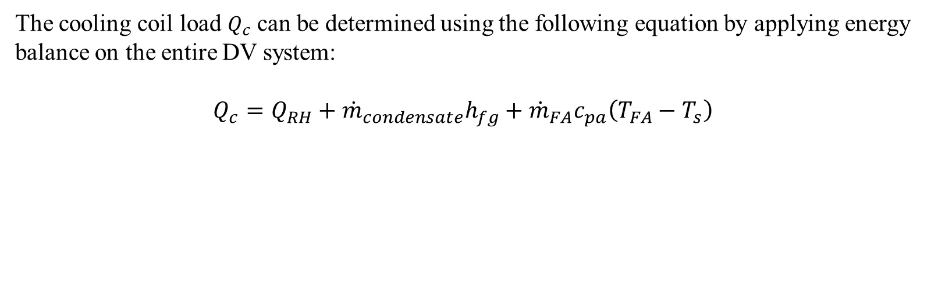
The cooling coil load $Q_{c}$ can be determined using the following equation by applying energy balance on the entire DV system:
$$Q_{c}=Q_{RH}+{\dot{m}}_{condensate}h_{fg}+{\dot{m}}_{FA}c_{pa}\left(T_{FA}−T_{s}\right)$$
Design | Qrh | m cond | hfg | mdot | Cpa | Ts | Qc (w)
1 | 5185.4 | 0.005101 | 2257 | 0.55 | 1005 | 18 | 13756.84
2 | 3666.3 | 0.003491 | 2257 | 0.37 | 1005 | 18 | 9784.129
3 | 3769.975 | 0.002941 | 2257 | 0.28 | 1005 | 19 | 8165.2
4 | 3149.96 | 0.002403 | 2257 | 0.22 | 1005 | 19 | 6787.254
5 | 3415.317 | 0.002179 | 2257 | 0.18 | 1005 | 20.5 | 6234.584
6 | 3041.971 | 0.001902 | 2257 | 0.16 | 1005 | 20.5 | 5537.137

Slide 15
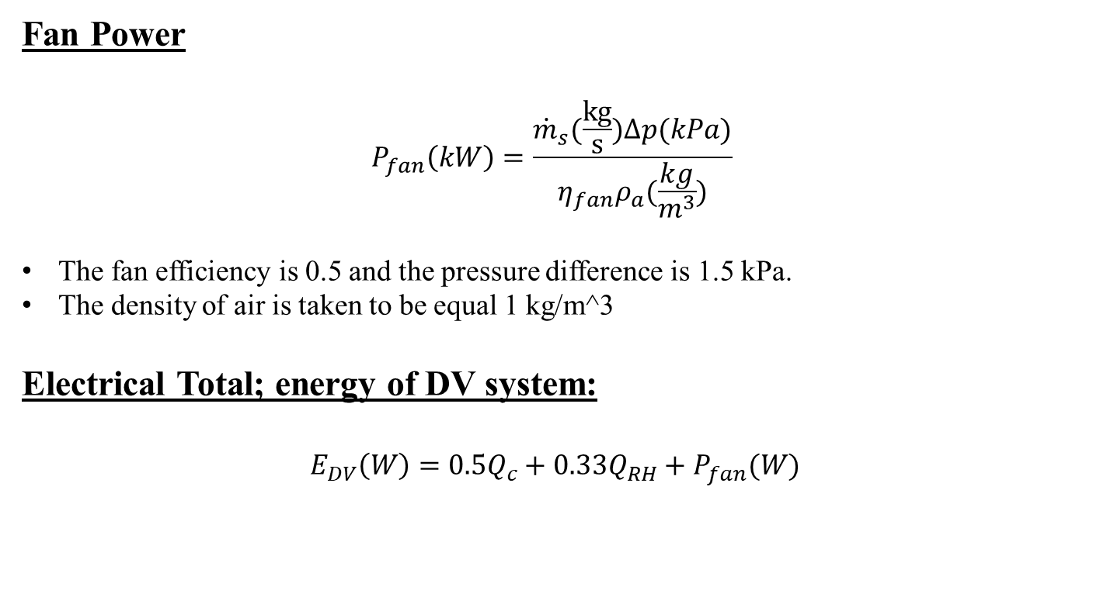
Fan Power
$$P_{fan}\left(kW\right)=\frac{{\dot{m}}_{s}(\frac{kg}{s})Δp(kPa)}{η_{fan}ρ_{a}(\frac{kg}{m^{3}})}$$
The fan efficiency is 0.5 and the pressure difference is 1.5 kPa.
The density of air is taken to be equal 1 kg/m^3
Electrical Total; energy of DV system:
$$E_{DV}\left(W\right)=0.5Q_{c}+0.33Q_{RH}+P_{fan}(W)$$
Design | mdot | fan power P (W) | E DV
1 | 0.55 | 1,650.00 | 10,239.60
2 | 0.37 | 1,100.00 | 7,201.94
3 | 0.28 | 825 | 6,151.69
4 | 0.22 | 660 | 5,093.11
5 | 0.18 | 550 | 4,794.35
6 | 0.16 | 471.43 | 4,243.85

Slide 16

Chilled ceiling water exiting temperature Tw,out:
$$T_{w,out}=2T_{c}−T_{w,im}$$
Pump’s mass flow rate ${\dot{m}}_{w}$:
$${\dot{m}}_{w}=\frac{Q_{cc}}{c_{pw}\left(T_{w,out}−T_{w,in}\right)}$$
Pump Power:
$$P_{pump}=\frac{{\dot{m}}_{w}gH_{p}}{η_{p}}$$
Total System Electrical Energy:
$$E_{total}=P_{pump}+E_{DV}$$
Design | mw | Tw_out | Ppump | E total
1 | 0.039286 | 19 | 1.926964 | 10,241.53
2 | 0.045833 | 19 | 2.248125 | 7,204.19
3 | 0.124405 | 17 | 6.102054 | 6,157.79
4 | 0.1375 | 17 | 6.744375 | 5,099.86
5 | 0.30119 | 16 | 14.77339 | 4,809.12
6 | 0.314286 | 16 | 15.41571 | 4,259.26

Slide 17
Relative Humidity Ratio Calculation:
Designs | Tr (degrees Celsius) | Specific Humidity (HR) (Kg of H2O/Kg of air | Relative Humidity (%)
1 | 20.61473 | 0.007251224 | 47%
2 | 20.82476 | 0.007158051 | 45%
3 | 22.28686 | 0.006137678 | 40%
4 | 22.49689 | 0.006059797 | 38%
5 | 24.33293 | 0.005251669 | 35%
6 | 24.55495 | 0.005182324 | 31%

Slide 18
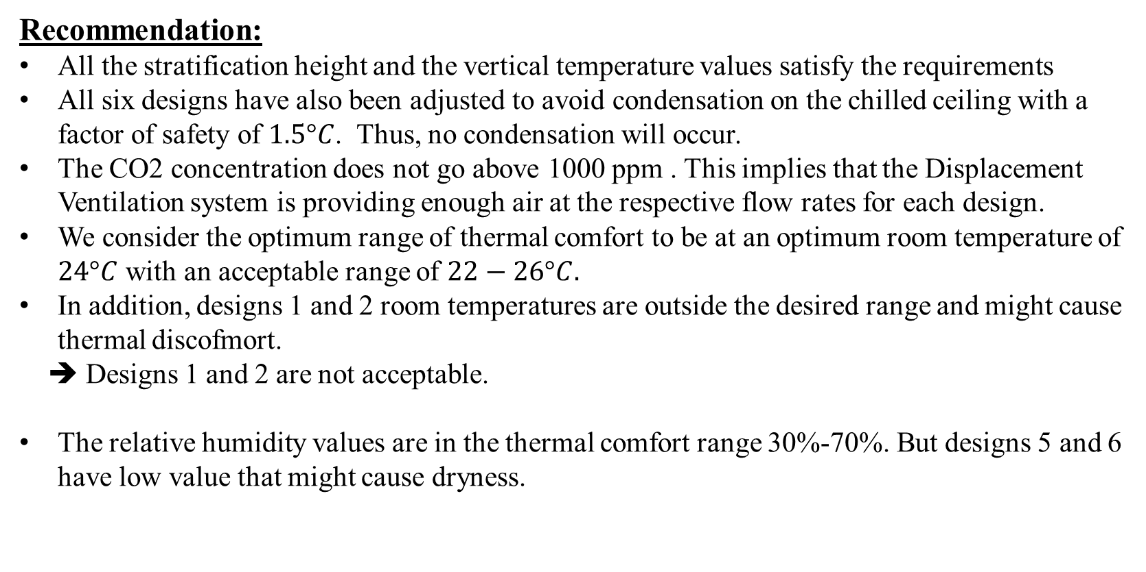
Recommendation:
All the stratification height and the vertical temperature values satisfy the requirements
All six designs have also been adjusted to avoid condensation on the chilled ceiling with a factor of safety of $1.5°C$. Thus, no condensation will occur.
The CO2 concentration does not go above 1000 ppm . This implies that the Displacement Ventilation system is providing enough air at the respective flow rates for each design.
We consider the optimum range of thermal comfort to be at an optimum room temperature of $24°C$ with an acceptable range of $22−26°C.$
In addition, designs 1 and 2 room temperatures are outside the desired range and might cause thermal discofmort.
➔ Designs 1 and 2 are not acceptable.
The relative humidity values are in the thermal comfort range 30%-70%. But designs 5 and 6 have low value that might cause dryness.

Slide 19
 | Tr | RH | Etot
Design 3 | 22.28685625 | 40 | 6,157.79
Design 4 | 22.49689375 | 38 | 5,099.86
Design 5 | 24.33293125 | 35 | 4,809.12
Design 6 | 24.55495 | 31 | 4,259.26
➔The table above shows that design 6 is the most energy efficient design.

Slide 20
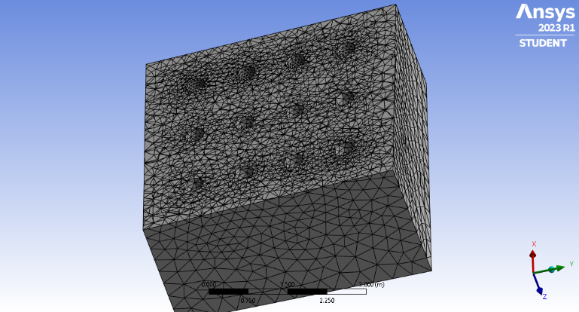
Simulation
The occupants were represented by 12 cylinders with height 1.1m distributed evenly in the room with the following mesh.
The meshing of both systems is done in a manner to obtain around 150000 elements with an average orthogonality of 0.76 and a maximum skewness of 0.8. Inflation is applied in the space surrounding the occupants to allow for better resolution since this volume is the most important

Slide 21
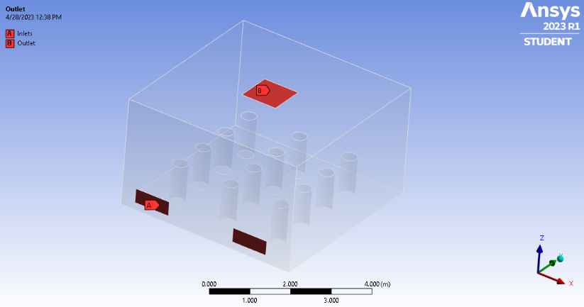
Simulation
The CCDV system had 2 inlets at the base of the wall and the outlet in the ceiling.

Slide 22
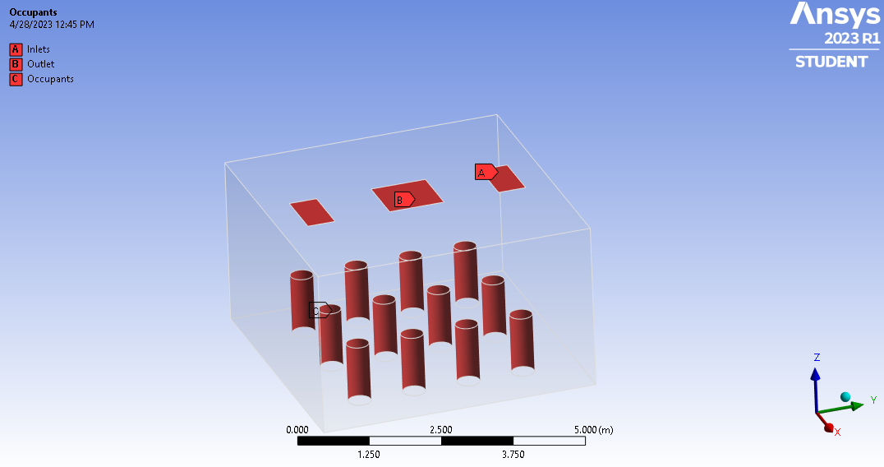
Simulation
The Mixed ventilation system had 2 inlets and 1 outlet in the ceiling.

Slide 23

Simulation Conditions
We imposed a 0.16kg/s flow rate of air at the inlets of both systems
The temperature of the inlet flow for both systems is taken as that of the ambient 20.5$°$C for CCDV as indicated in the design
The CCDV system has a ceiling temperature of 15.5$°$C

Slide 24
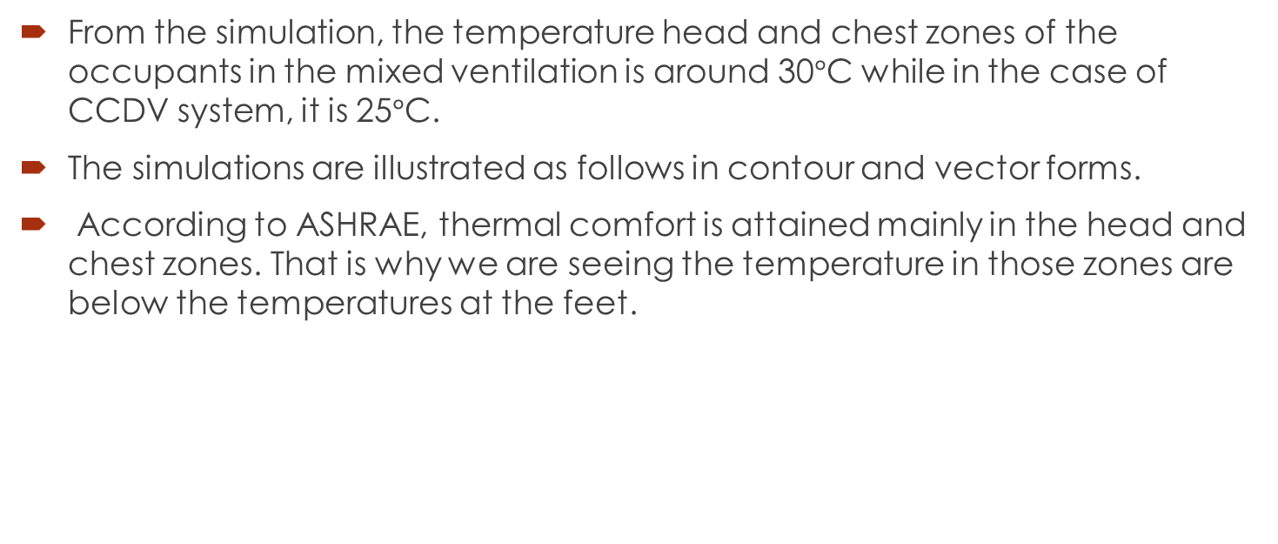
Simulation Results
From the simulation, the temperature head and chest zones of the occupants in the mixed ventilation is around 30$°$C while in the case of CCDV system, it is 25$°$C.
The simulations are illustrated as follows in contour and vector forms.
According to ASHRAE, thermal comfort is attained mainly in the head and chest zones. That is why we are seeing the temperature in those zones are below the temperatures at the feet.

Slide 25
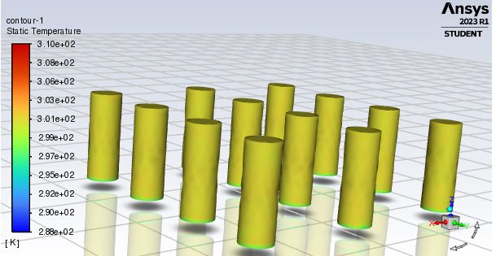
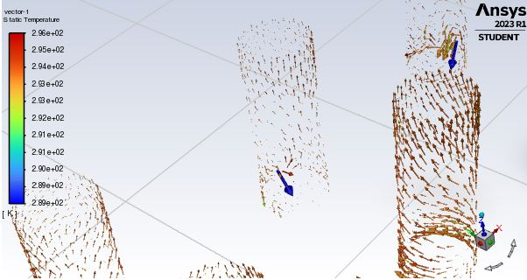
CCDV Results

Slide 26
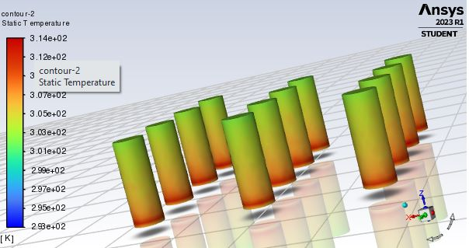
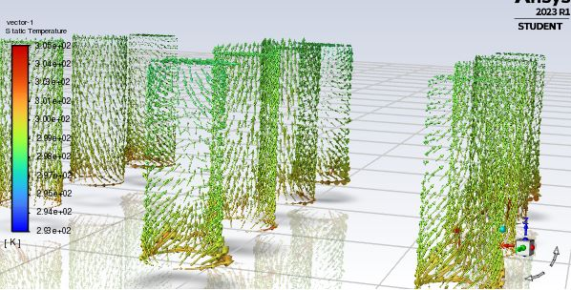
Mixed Ventilation Results

Slide 27
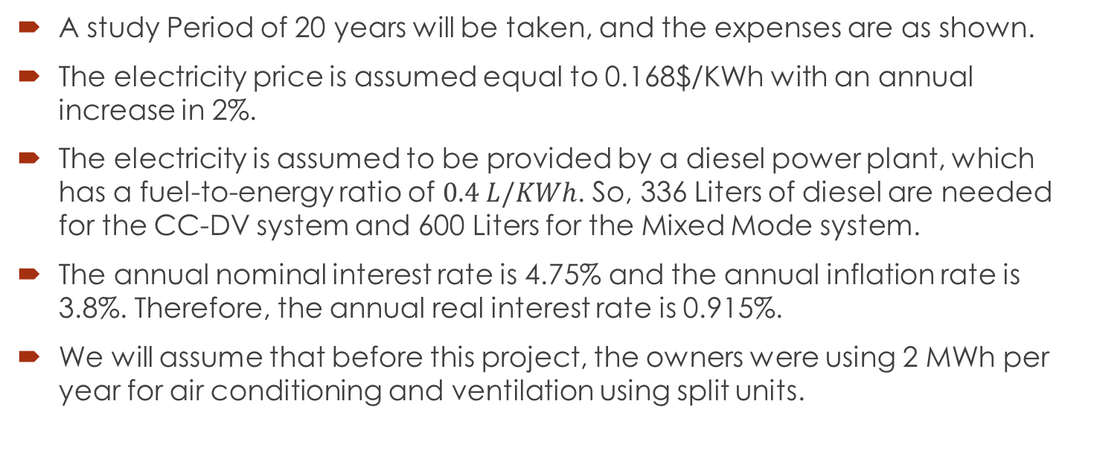
Economic Analysis
A study Period of 20 years will be taken, and the expenses are as shown.
The electricity price is assumed equal to 0.168$/KWh with an annual increase in 2%.
The electricity is assumed to be provided by a diesel power plant, which has a fuel-to-energy ratio of $0.4 L/KWh$. So, 336 Liters of diesel are needed for the CC-DV system and 600 Liters for the Mixed Mode system.
The annual nominal interest rate is 4.75% and the annual inflation rate is 3.8%. Therefore, the annual real interest rate is 0.915%.
We will assume that before this project, the owners were using 2 MWh per year for air conditioning and ventilation using split units.

Slide 28
Cash Flows

Slide 29
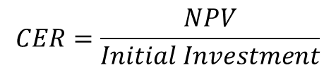
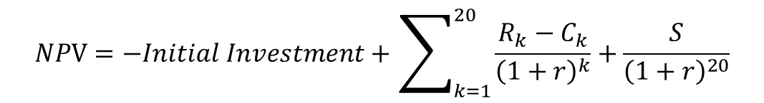
NPV and CER
$$NPV=−Initial Investment+\sum_{k=1}^{20}{\frac{R_{k}−C_{k}}{{\left(1+r\right)}^{k}}}+\frac{S}{{\left(1+r\right)}^{20}}$$
$$CER=\frac{NPV}{Initial Investment}$$

Slide 30
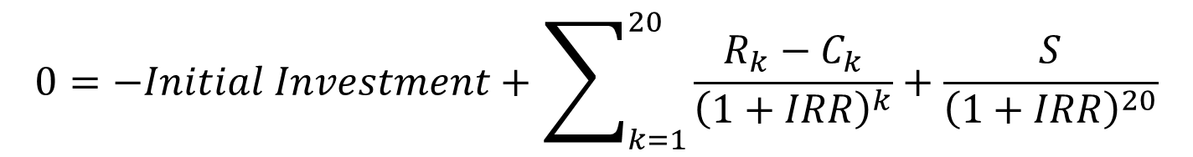
Internal Rate of Return
$$0=−Initial Investment+\sum_{k=1}^{20}{\frac{R_{k}−C_{k}}{{\left(1+IRR\right)}^{k}}}+\frac{S}{{\left(1+IRR\right)}^{20}}$$

Slide 31


Results
System | NPV($) | IRR | CER
CCDV | 2046.30 | 8% | 0.974430167
Mixed Mode | 557.36 | 5% | 0.491496583
$$IRR_{ccdv}>IRR_{mixedmode}$$
$$CER_{ccdv}>CER_{mixedmode}$$
→ CCDV better using these 2 parameters

Slide 32

Benefit-Cost Analysis
$$B/C=\frac{ΣNPV_{benefit}}{ΣNPV_{cost}}$$
$$ΣNPV_{benefit}=\sum_{k=1}^{20}{\frac{R_{k}}{{\left(1+r\right)}^{k}}}+\frac{S}{{\left(1+r\right)}^{20}}$$
$$ΣNPV_{cost}=Initial Investment+\sum_{k=1}^{20}{\frac{C_{k}}{{\left(1+r\right)}^{k}}}$$

Slide 33
Benefits and costs without interest

Slide 34
NPV of Benefits and Costs

Slide 35

Benefit-Cost Ratio (B/C)
System | NPV Benefit | NPV Costs | B/C Ratio
CCDV | 7430.01 | -5383.71 | 1.380091819
Mixed Mode | 7426.68 | -6869.32 | 1.081137156
$B/C_{ccdv}$ > $B/C_{mixedmode}$
→ CCDV is better based on Benefit-Cost Analysis

Slide 36
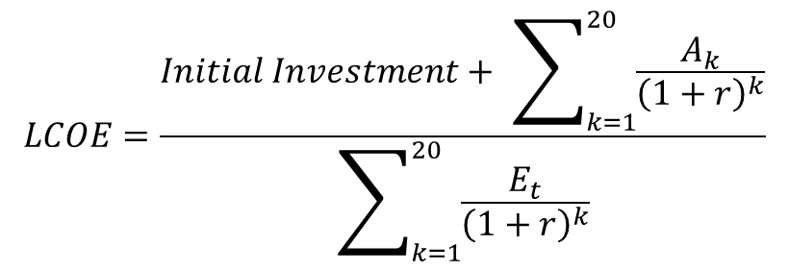
Electricity Generation Analysis
System | Initial Invest +Installation | Annual Energy cost($) | Annual Energy Production(kWh)
Full Diesel | 0 | 1500*electricity cost | 1500
Half Diesel Half PV | 1000 | 840*electricity cost | 1680
$$LCOE=\frac{Initial Investment+ \sum_{k=1}^{20}{\frac{A_{k}}{{\left(1+r\right)}^{k}}}}{\sum_{k=1}^{20}{\frac{E_{t}}{{\left(1+r\right)}^{k}}}}$$

Slide 37
Energy Cost Cash Flows and NPV

Slide 38
Energy produced including interest

Slide 39

Levelised Cost of Electricity
System | Sum Cost | Sum Energy | LCOE($/kWh)
Full Diesel | 5538.754778 | 27300.79291 | 0.202878898
Half Diesel Half PV | 4101.702676 | 30576.88806 | 0.134143889
$$LCOE_{half diesel half PV}<LCOE_{full diesel}$$
→ Encouraging the use of the CCDV system based on cost of electricity.

Slide 40
Final Decision
All methods of analysis either CER, IRR, benefit-cost, or electricity cost indicate that the better HVAC system to be used is the CCDV system in this problem.
CCDV > Mixed-Mode

Slide 41
Thank you

